Slide 1

WEB GIS

Slide 2
WEB
GIS
Web Page, User Friendly, Internet, Web Scripting language (HTML, CSS, JS, PHP and more)
Hardware, Software, Data, GIS Analyst, Output to users.
WEB GIS
Client Side
Server side
(GIS Server)
Web App, Mobile app
User friendly Ex. Google map
Development side, Database, Scripting, everything to make App work and make it user friendly
WEB GIS can be defined as any GIS that uses web technology to communicate between a server and a client.

Slide 3
Why WEB GIS?
Global Reach - Show your work to the world, high accessibility
Large users - Desktop GIS only one user, Web GIS Millions of user
Cross Platform Capability – Web browser, HTML and JS, available on any OS.
Low Cost - Need not buy separate software license for each users, Create one and share it, work at field or home.
Easy to use – Intended for Broad audience, designed for simplicity, intuition and convenience
Unified updates – update all client side at once
Diverse Application – Used for wide application

Slide 4
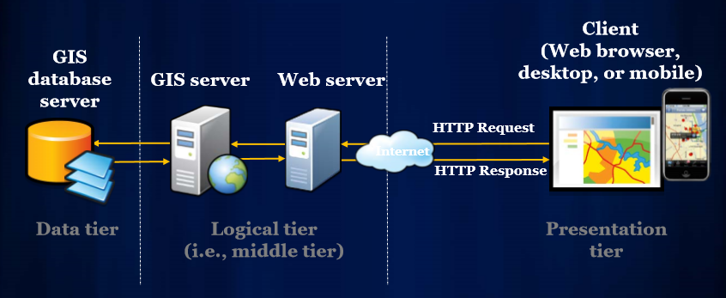
Basic Web GIS Architecture

Slide 5
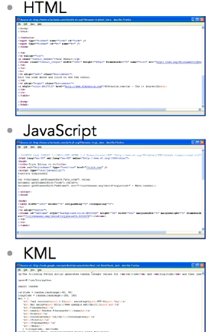
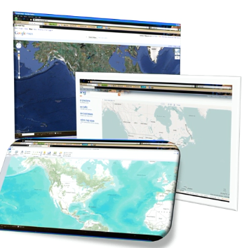
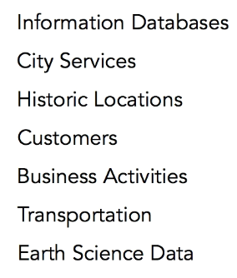
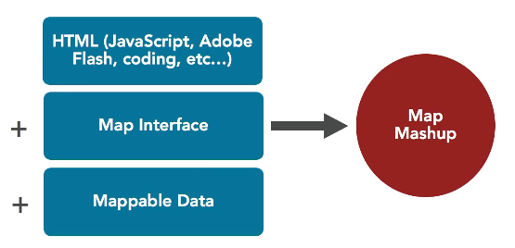

Slide 6
Geodatabase
SHP File/ DBfile
SQL file
PostGIS
PostGIS
Map Server
Web Maps
Web GIS
User Interaction
Simple
Complex
Read only
Read /write
* PostGIS is an extension to the PostgreSQL object-relational database system which allows GIS (Geographic Information Systems) objects to be stored in the database.
*PostgreSQL is (ORDBMS) Object-Relational Database Management System (open source).

Slide 7
How do we do it?
Use Available Open Source/Proprietary sources.
Create everything from the scratch.

Slide 8
Available sources
Google Maps
Bing Maps
ESRI – ArcGIS Online System(GIS server + WEBGIS)
Open source Web GIS and GIS Server
Geoserver (Server)
Leafletjs (Web GIS)
Mapbox
Pseudo GIS, Good for Visualization, Analysis can not be done over this

Slide 9
API for Web Mapping
Application Programming Interface.
Create custom application with programming languages.
Create GUI
Esri, Google and Bing has its specific API
Javascript, .NET, Java API are available with esri
Leafletjs (Open source) has Javascript API

Slide 10
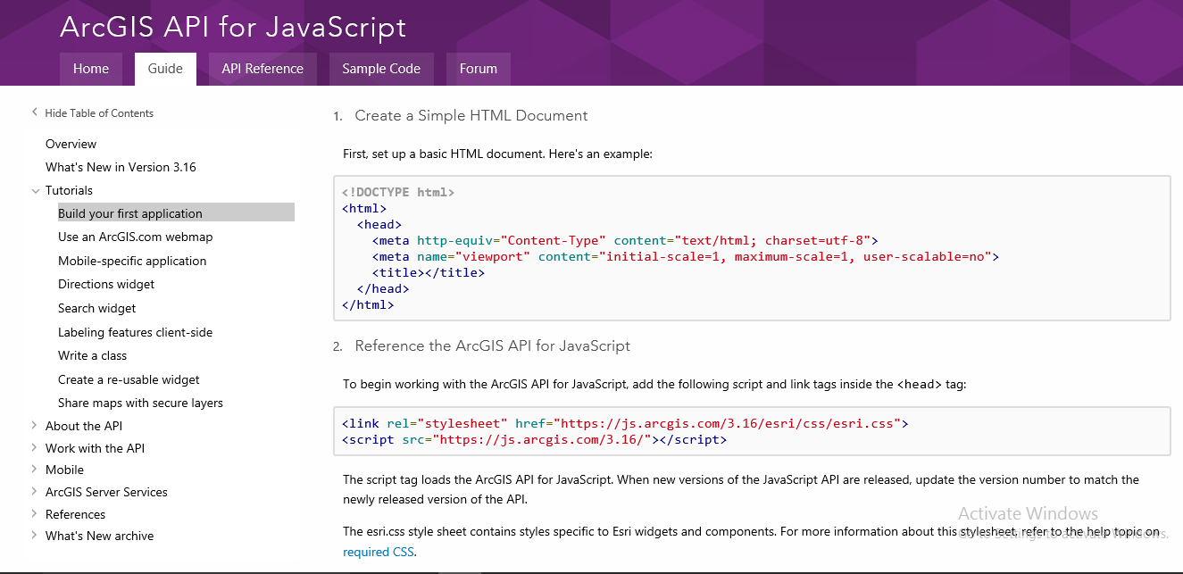

Slide 11
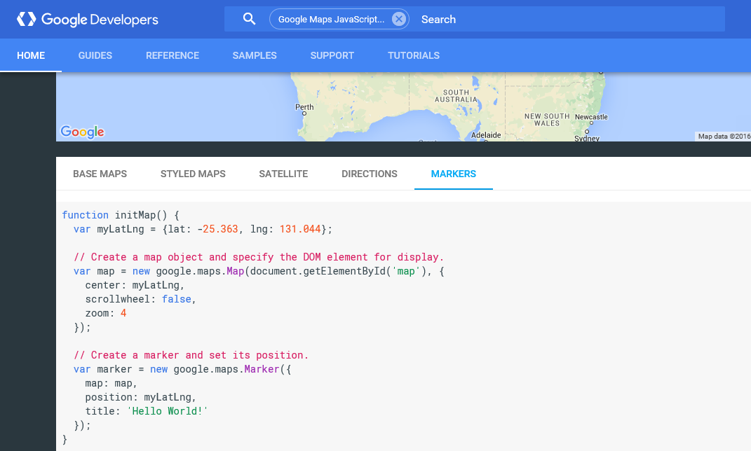

Slide 12
Building a Web GIS
Web GIS Architecture Setup (IT skills)
Data Production and Manipulation (SQL + Geo Skills)
Web Map Configuration and Styling (Styling + Geo)
Map User interaction (Javascript)

Slide 13
Packages/modules for Web GIS
Storing and Organizing Data
PostgreSQL(Database)
PostGIS (For spatial data)
pgAdmin(GUI database)
Manipulation
GDAL (Raster format data)
OGR (Shapefile format)
PROJ.4 (Projections)
Generate and Publish Map
Map Server (Generate Maps)
PHP+Mapscript
Web server (HTML)
User Interaction
Javascript
Openlayer
ExtJS

Slide 14
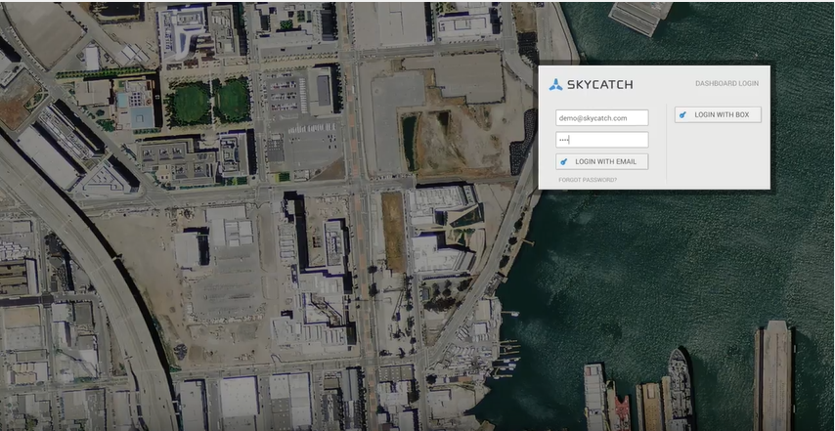
Skycatch
Web app – Dashboard

Slide 15
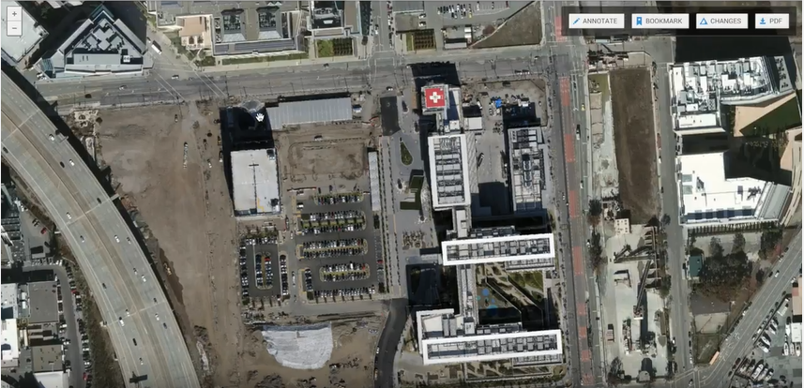

Slide 16
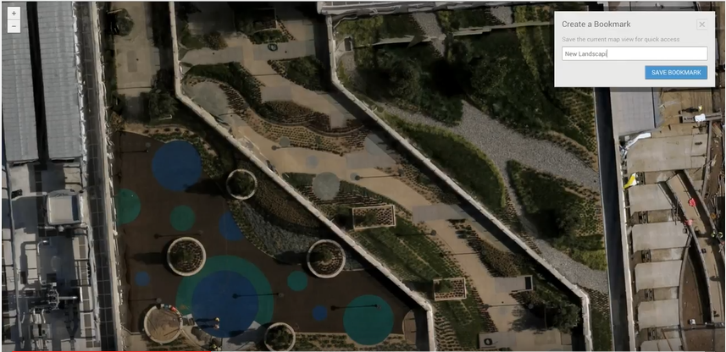

Slide 17
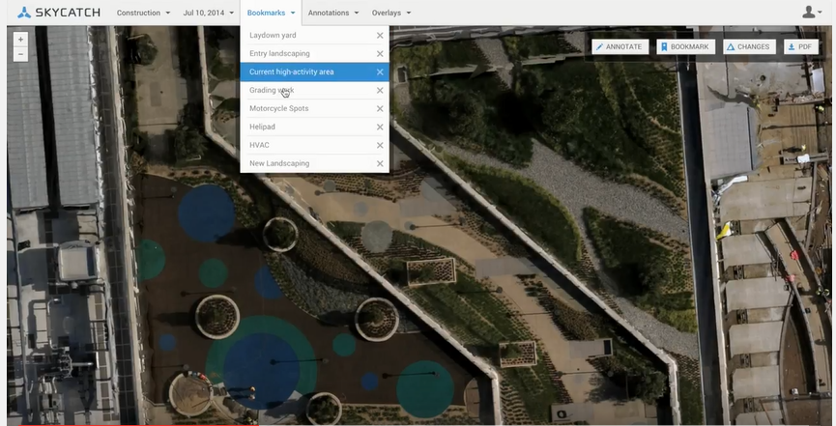

Slide 18
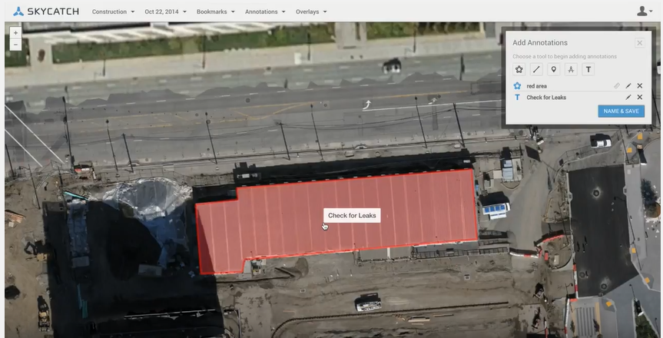

Slide 19
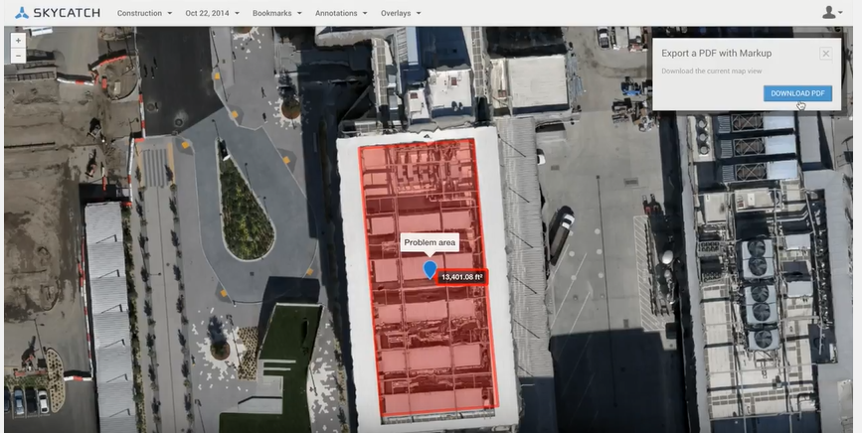

Slide 20
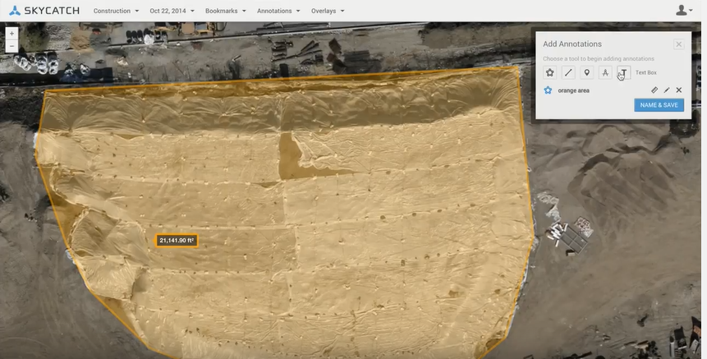

Slide 21
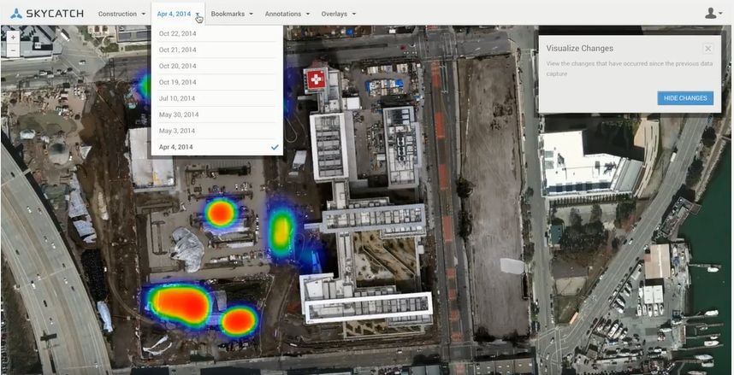

Slide 22
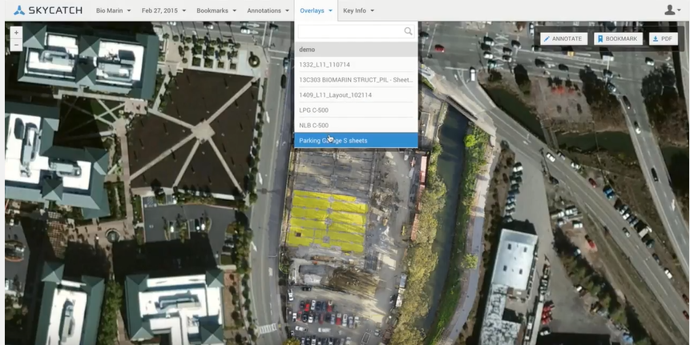

Slide 23
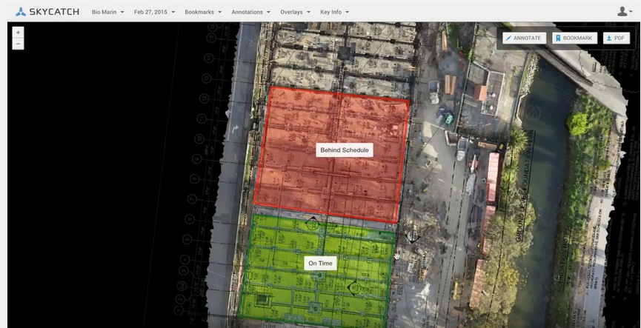

Slide 24
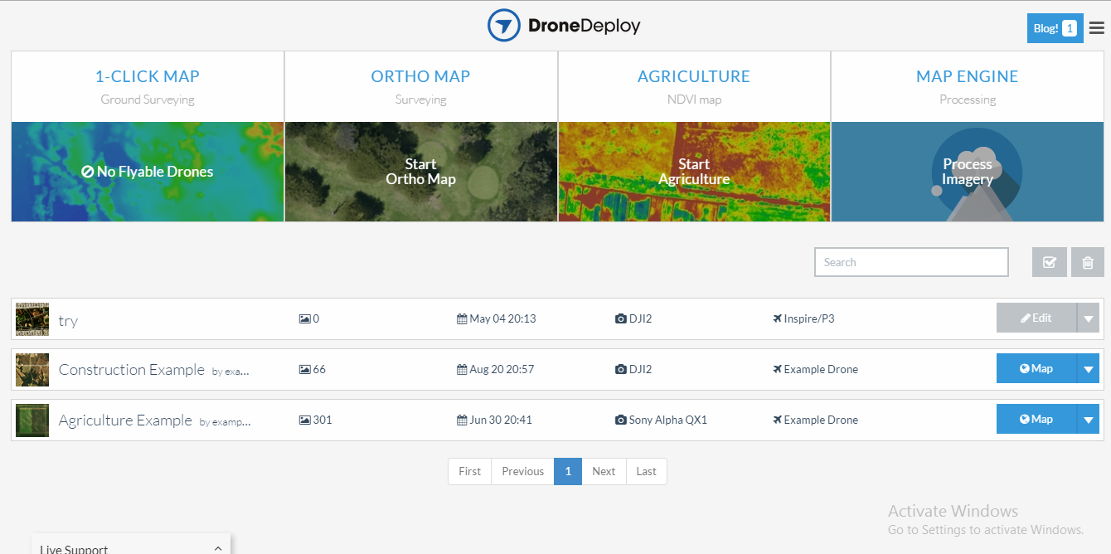
Drone Deploy

Slide 25
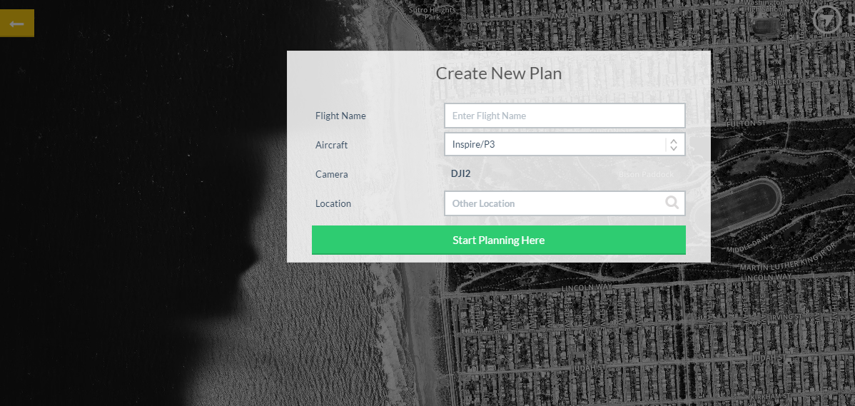

Slide 26
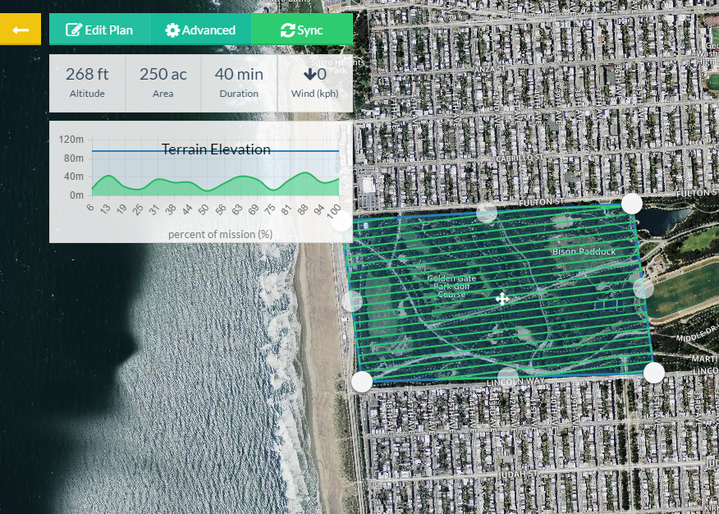

Slide 27
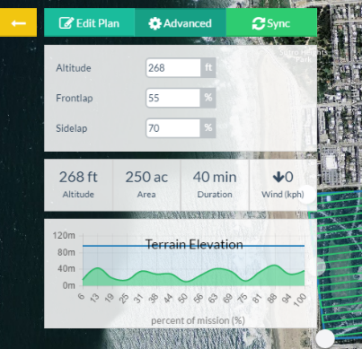
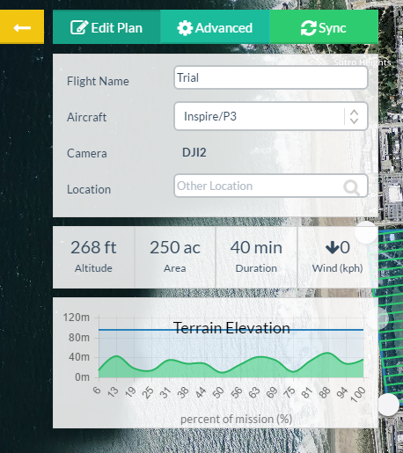
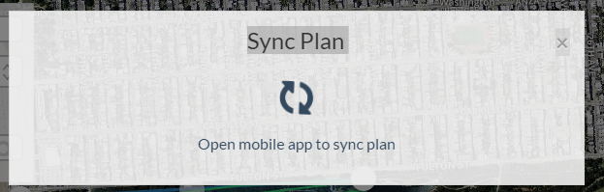

Slide 28
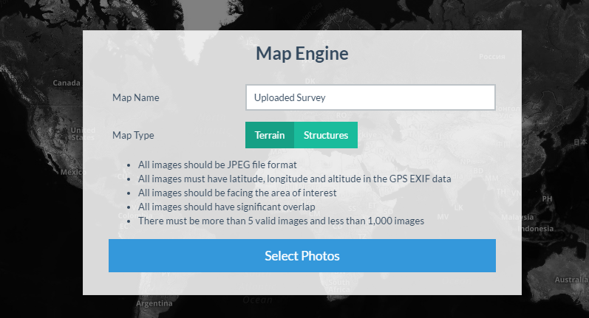

Slide 29
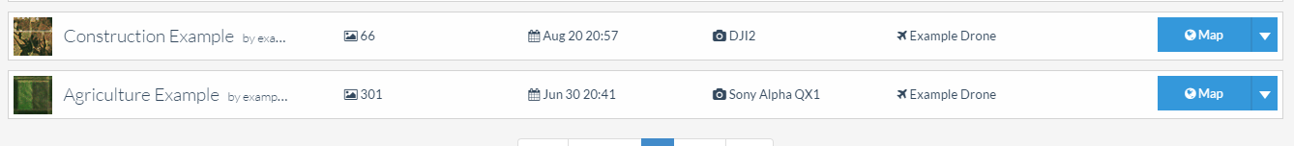
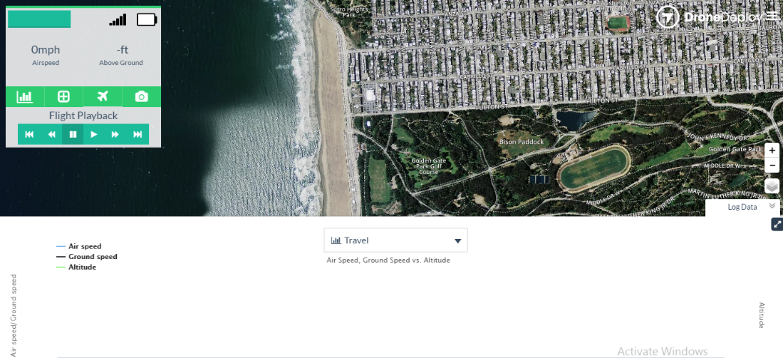
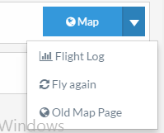

Slide 30
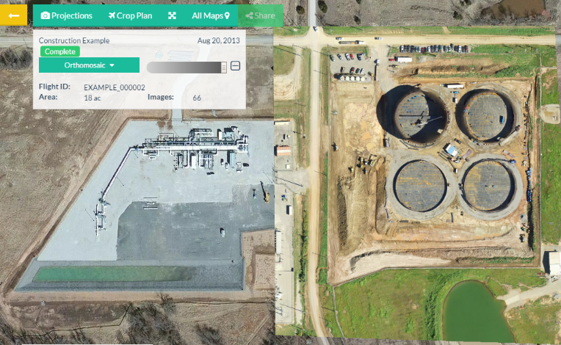
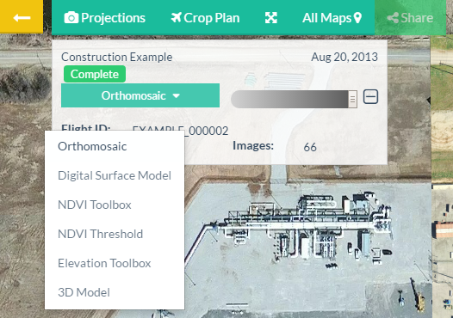
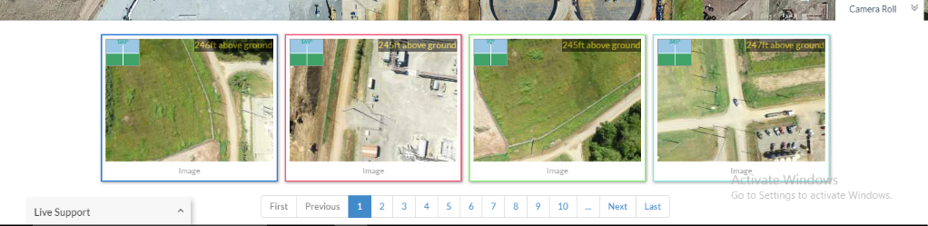

Slide 31
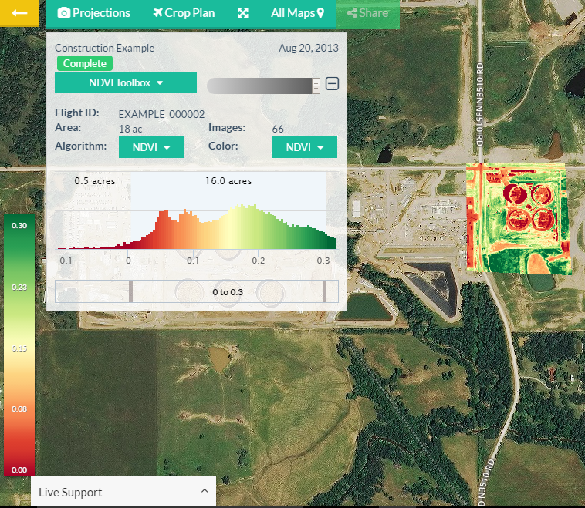

Slide 32
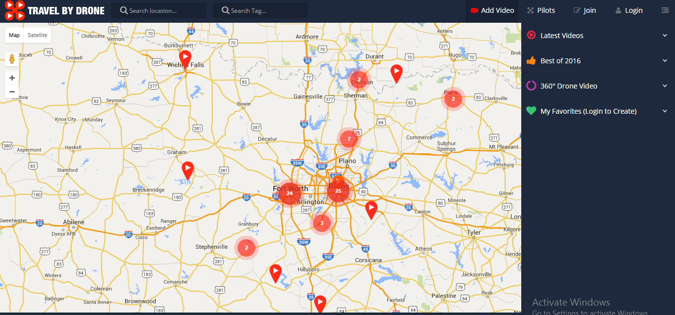

Slide 33
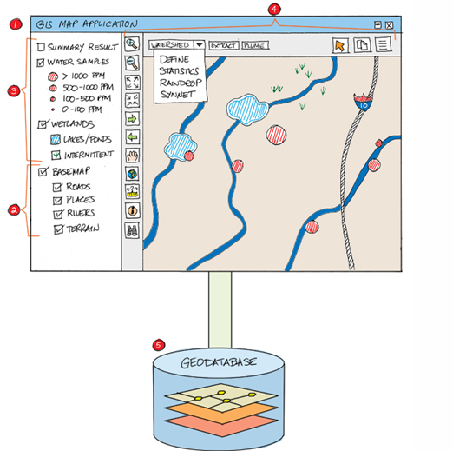
Framework
Web application
Digital Basemap
Operational Layers
Task and tools in the Web GIS application
Geodatabase

Slide 34
Web Application
Software interface for the client.
Visualize, interact and work with geographic info.
Runs on web browser or mobile.
Set of functions, tools and map displays required by the users.
Application choice will depend on end user

Slide 35
Basemap
Provides geographic context
Varies from application to application
Requires lot of skill and time to create your own base map
Online we have various base maps available
We can have a particular basemap or hybrid basemap with multiple layers

Slide 36
Operational Layers
Layers for particular set of users
Observation or sensor feeds
Editing & data access layers – User work with this data, to edit features, perform queries and select features for analysis.
Query results – Query to server and returns with set of records displayed on the map.
Result layer that are derived from analytic model – GIS analysis derived results can be used as a new layer and can be worked on.

Slide 37
Task and Tools
To perform processes beyond mapping
Have the client to do it : Easy processes, Data is all on client side
Have the server to do it : Complex process, ex. finding and routing to the closest facility

Slide 38
Geodatabse
Supports the application
Manages the geographic data

Slide 39
What we need to do next
Type of web application required for Surveys, Corridor, Mapping, Aerial photography and more
Task and tools to put up on each of this web app

Slide 40
Basic tools
Measurements – Length, Area, perimeter
Elevation info on the web map
Lat and Long
Draw a polygon, point, line (as shp file and save it)
Feature counting (any feature)

Slide 41
Corridor Mapping
Detailed info of feature present on the road (for both greenfield/brownfield project)
Cross section profile
Marking details.
Buffer analysis tool.

Slide 42
Mining
Contours at various contour interval
Volume measurement / details
Assets marking details
Slope stability analysis
Cross section profile

